Slide 1
Capstone One Visualization

Slide 2
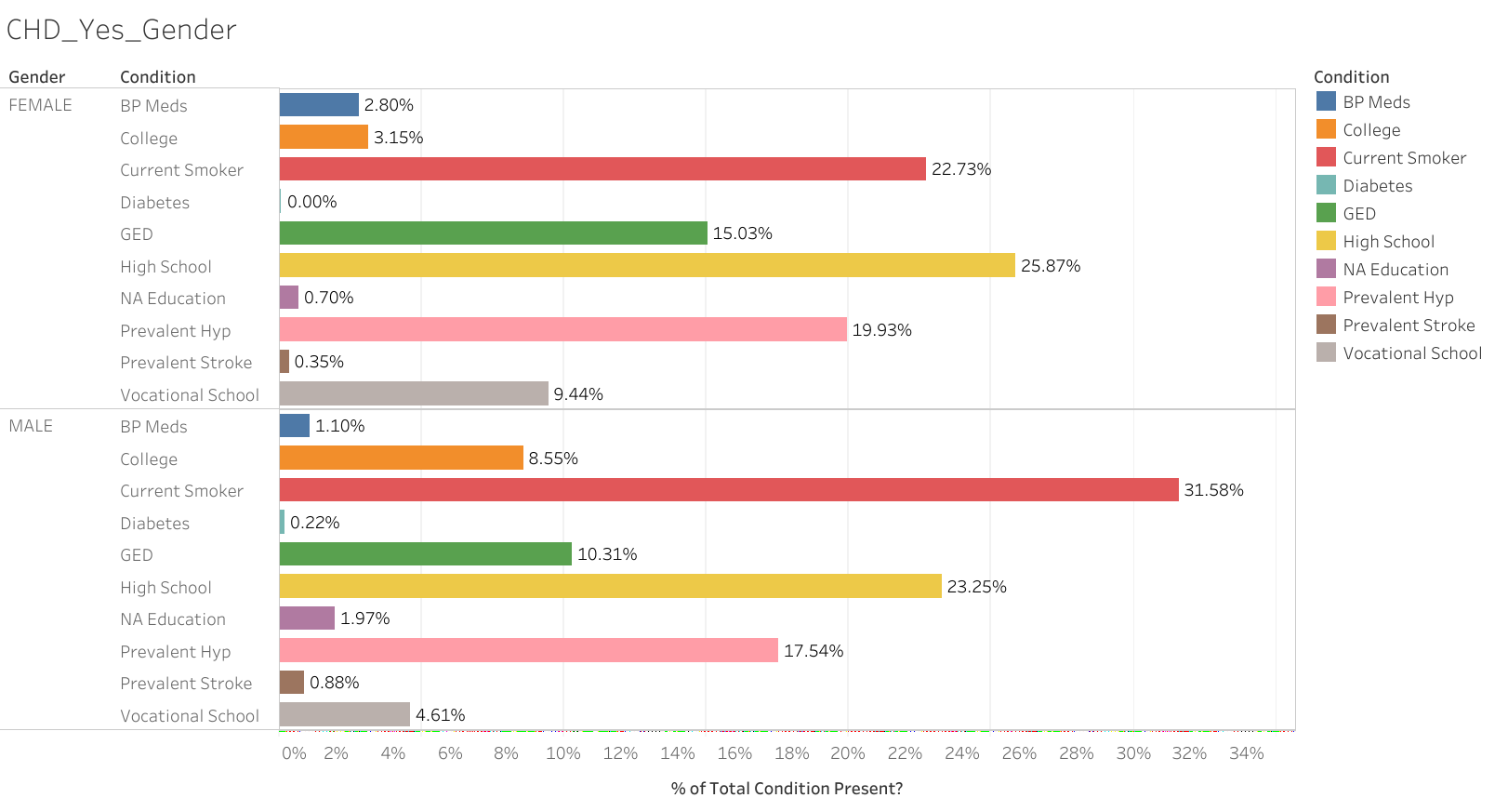
Comparison of various attributes that might effect CHD in men and women who had history of cognitive heart disease in last 10 years

Slide 3
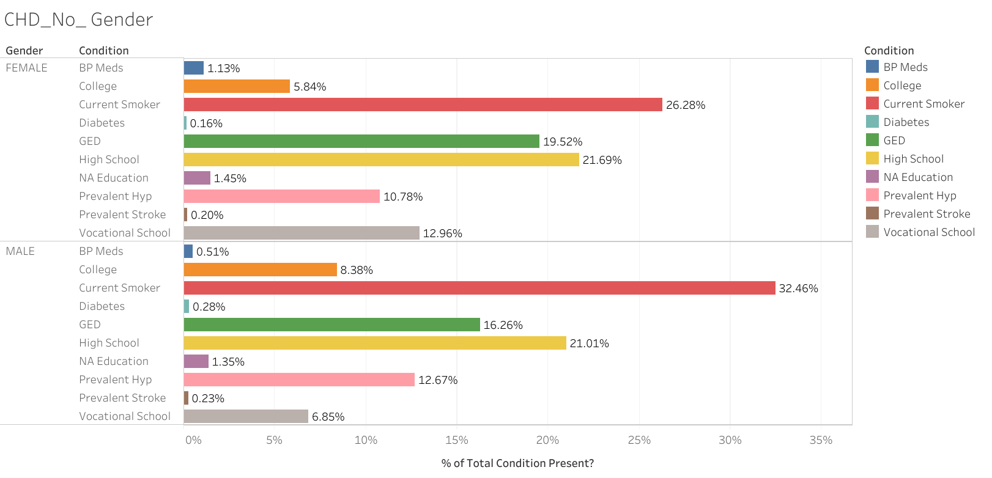
Comparison of various attributes that might effect CHD in men and women who never had a history of cognitive heart disease in last 10 years

Slide 4
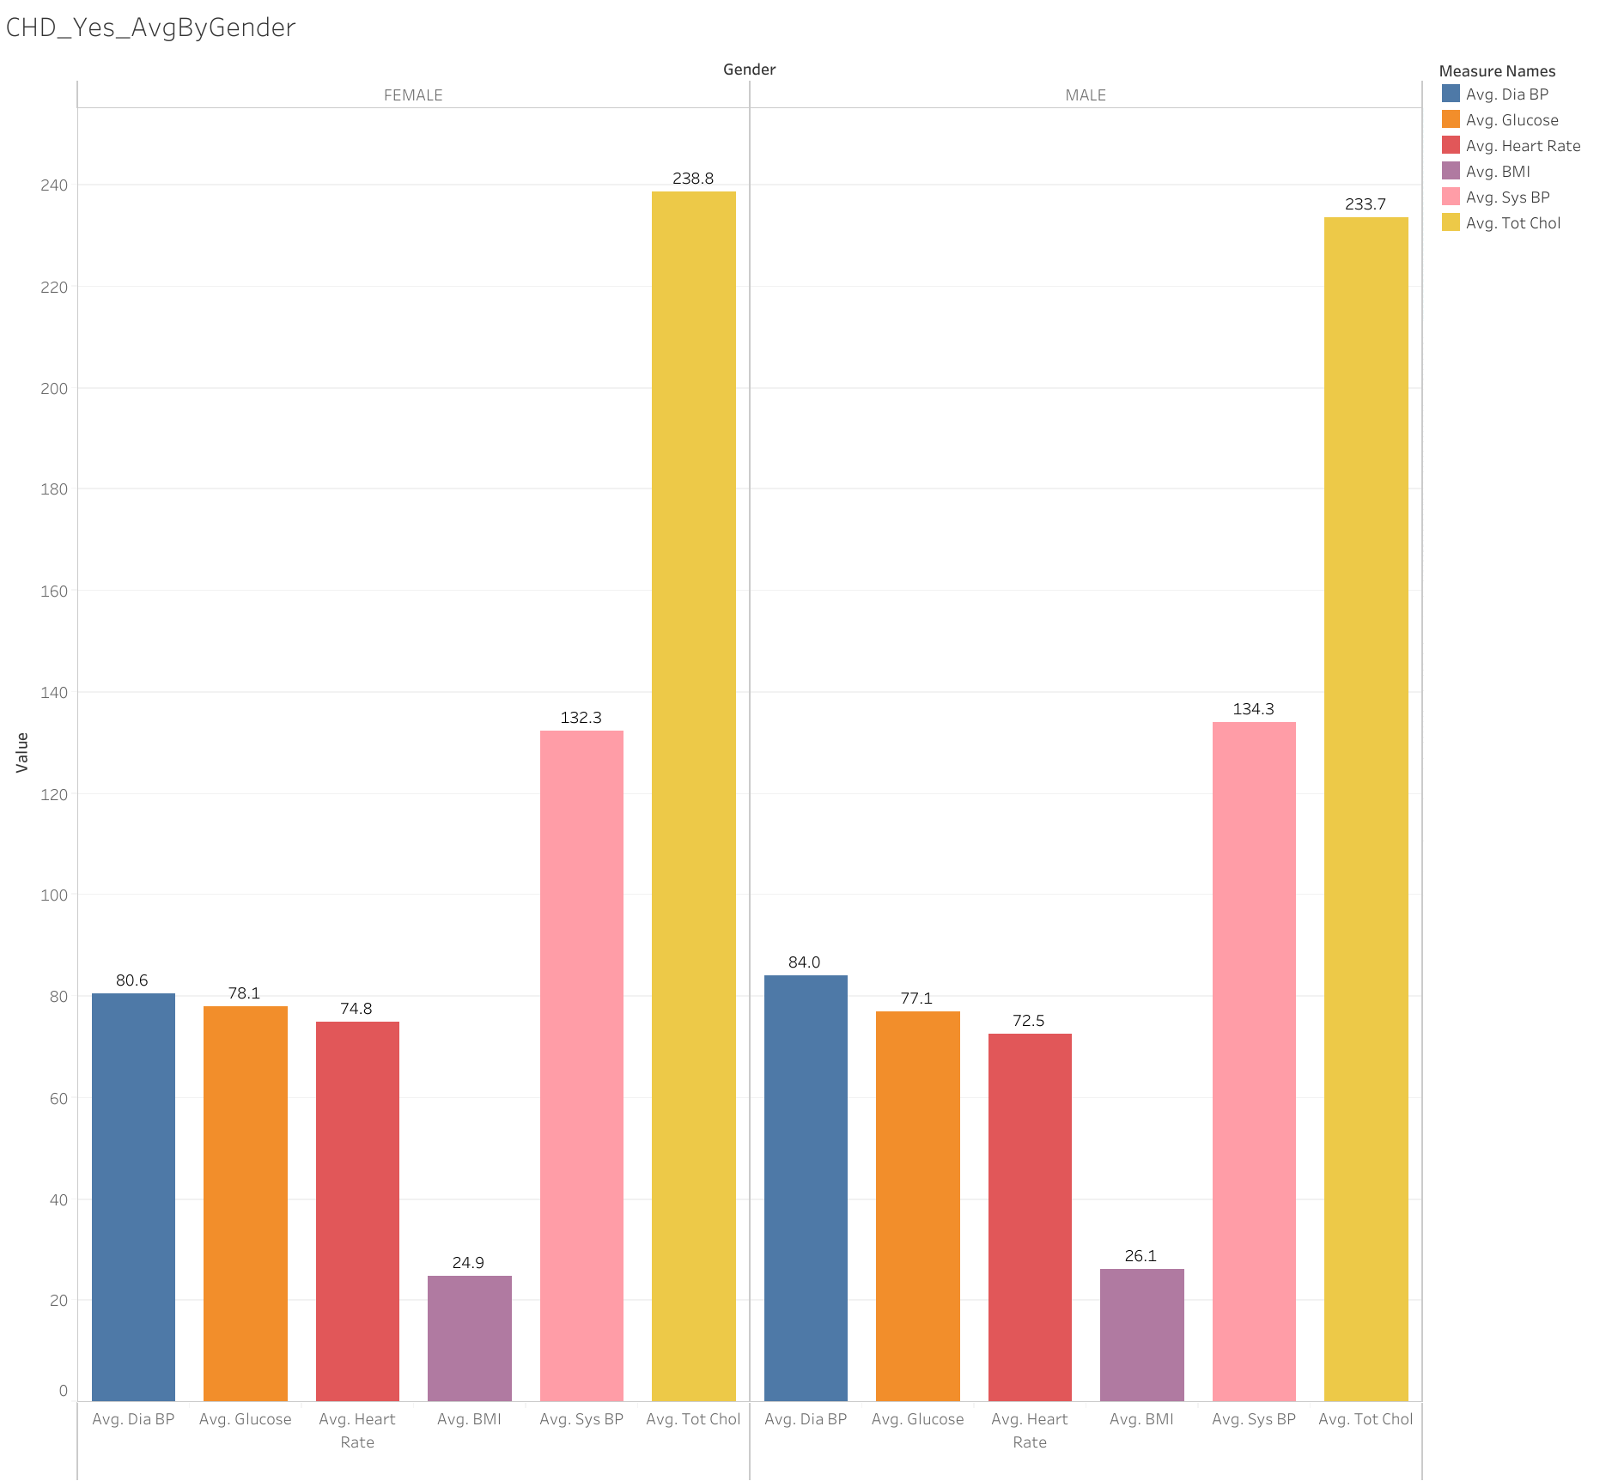
Average values of measurable attributes in men and women with a history of heart disease on last 10 years

Slide 5
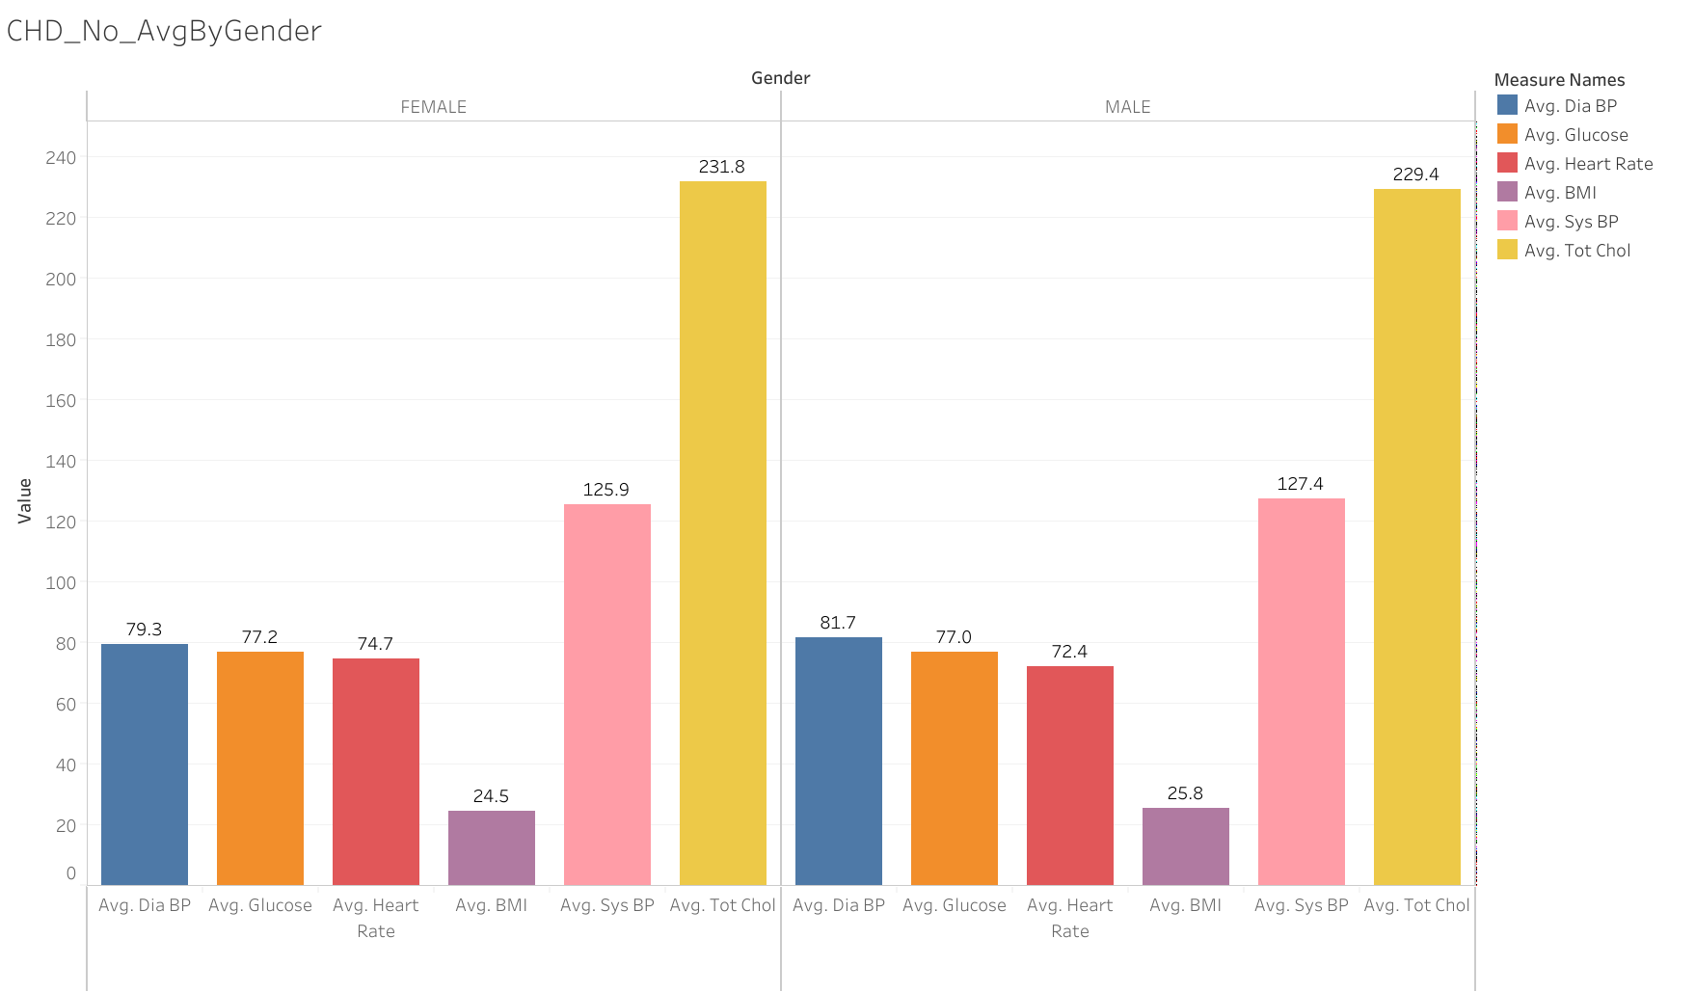
Average values of measurable attributes in men and women without a history of heart disease on last 10 years

